Slide 1
Twist Polynomials of Delta Matroids 2
By Lozinskiy Leon, Yuschak Daniel

Slide 2
Recap
Last time we introduced delta-matroids, the twist polynomial, and binary delta-matroids, in order to present our conclusion that all delta-matroids with twist polynomial a monomial are binary.

Slide 3
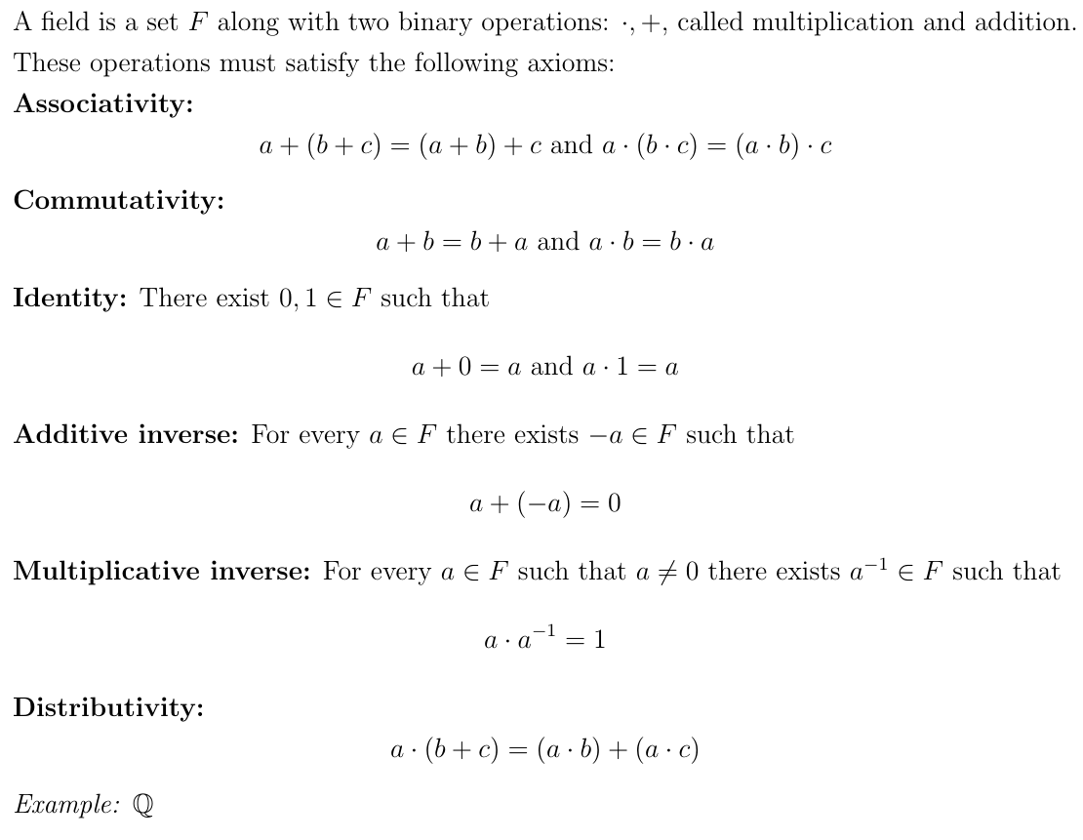
Introduction to Fields

Slide 4
Finite Fields

Slide 5
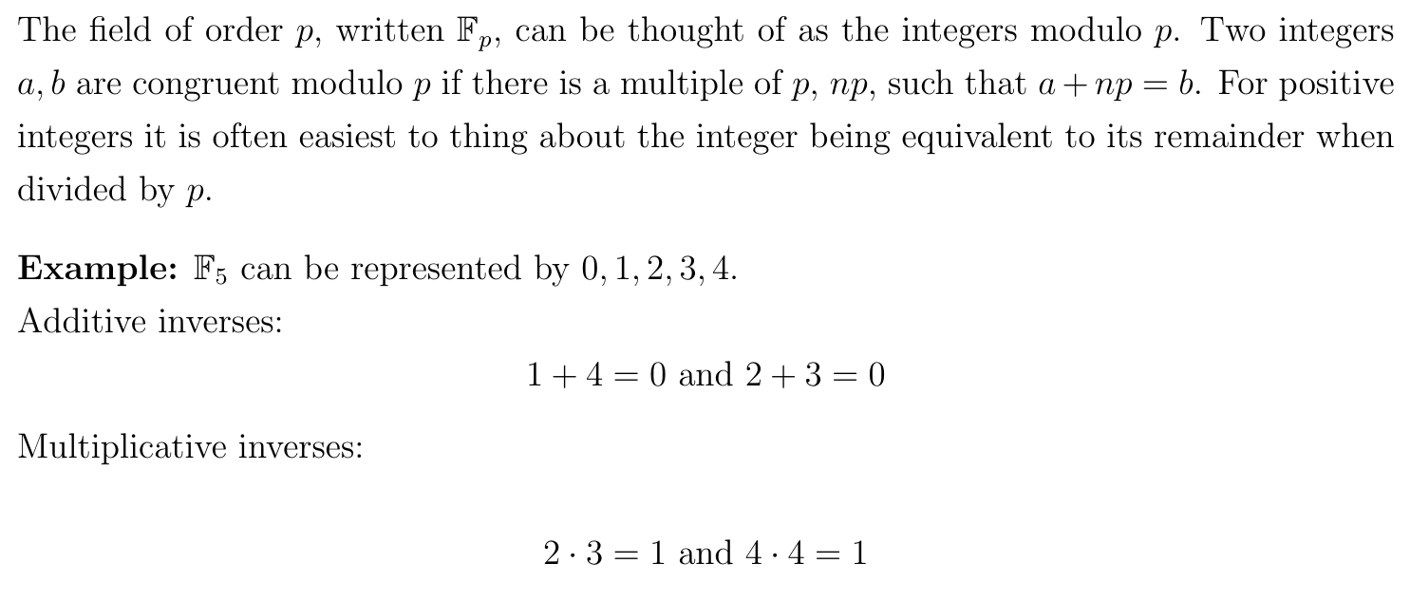
Fields of order p

Slide 6
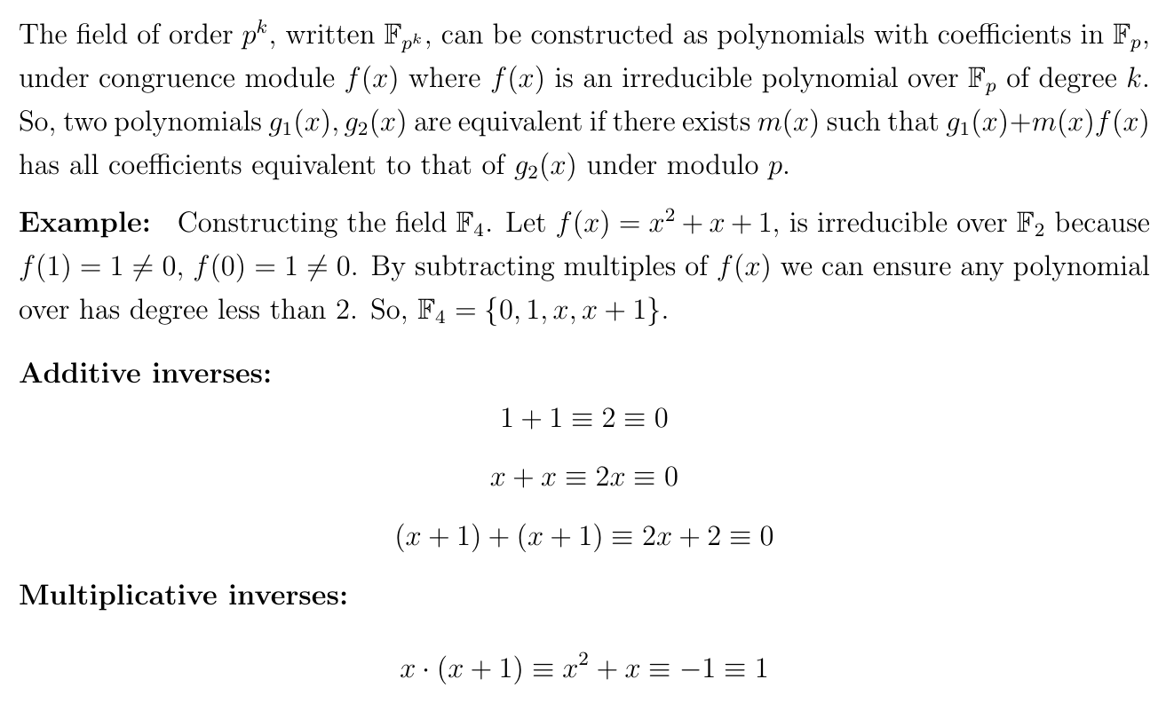
Fields of order p^k

Slide 7
What is representability again?

Slide 8
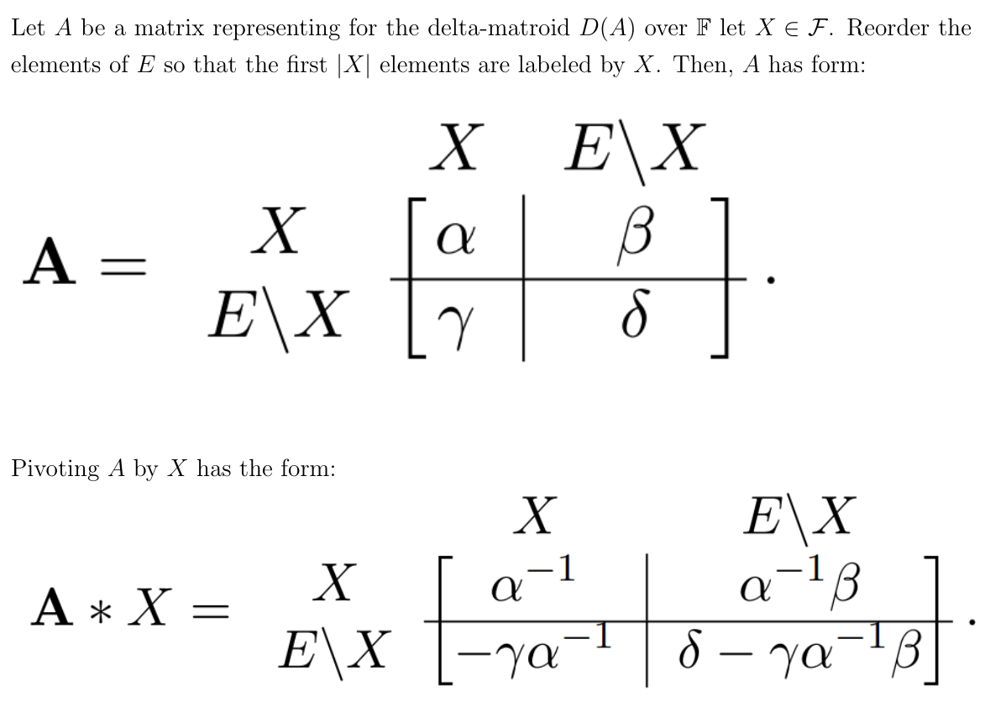
Pivoting

Slide 9
Pivoting and Deletion

Slide 10
What we want to do next.

Slide 11
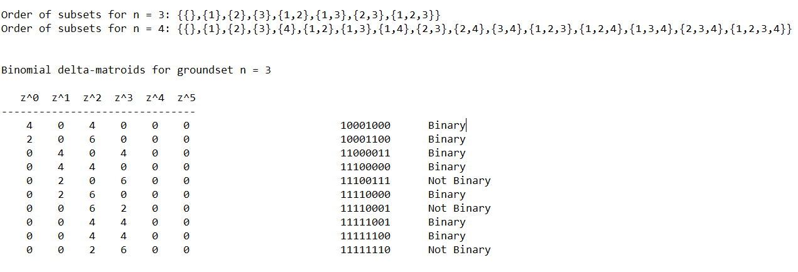
How programming is helpful.
Example: 10001000 = {{},{1,2}}

Slide 12
Twist Monomials
A delta-matroid has a twist monomial if and only if it is binary and is represented by a looped simple graph that is a disjoint union of single-vertex loops and unlooped complete graphs with an odd number of vertices.

Slide 13
Number of Twist Monomials and Binomials
n = 3:
16 delta-matroids
5 with monomials
15 with binomials
n = 4:
90 delta-matroids
7 with monomials
52 with binomials
n = 5:
2902 delta-matroids
10 with monomials
780 with binomials

Slide 14
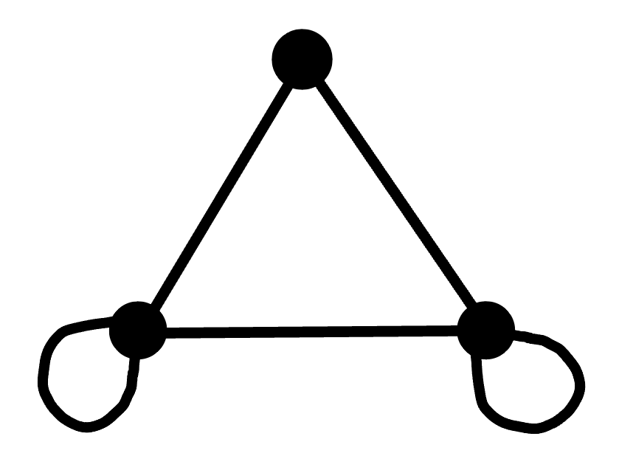
{∅, {1}, {2}, {1, 3}, {2, 3}}
1 1 1
1 1 1
1 1 0
4z³ + 2z² + 2z

Slide 15
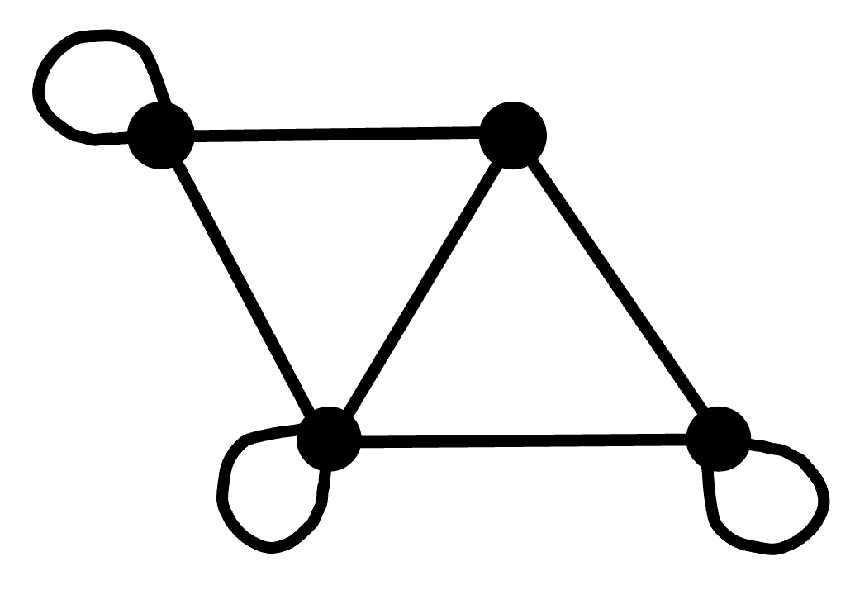
{∅, {1}, {2}, {1, 3}, {2, 3}}
1 1 1
1 1 1
1 1 0
4z³ + 2z² + 2z
1 1 1 1
1 1 1 0
1 1 0 1
1 0 1 1
{∅, {1}, {2}, {4}, {1, 3}, {2, 3}, {2, 4}, {3, 4}, {1, 2, 4}, {1, 2, 3, 4}}
4z⁴ + 12z³

Slide 16
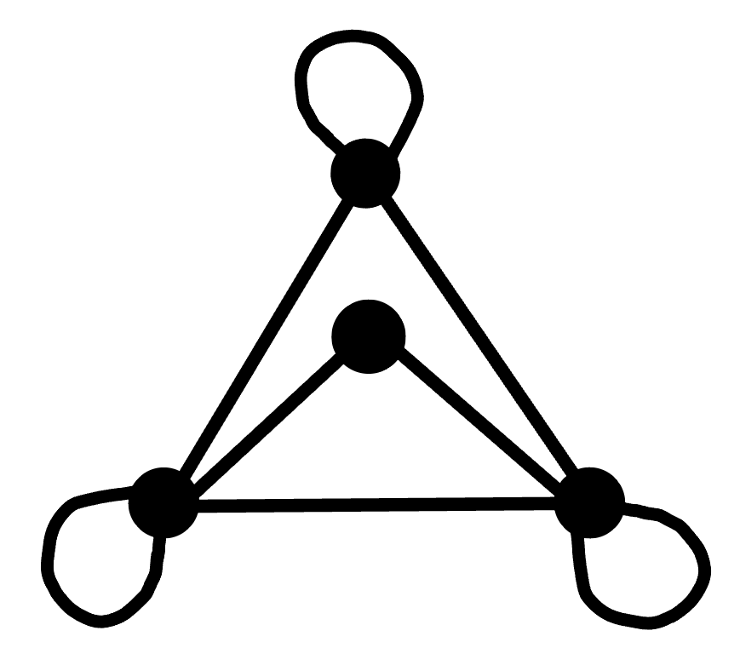
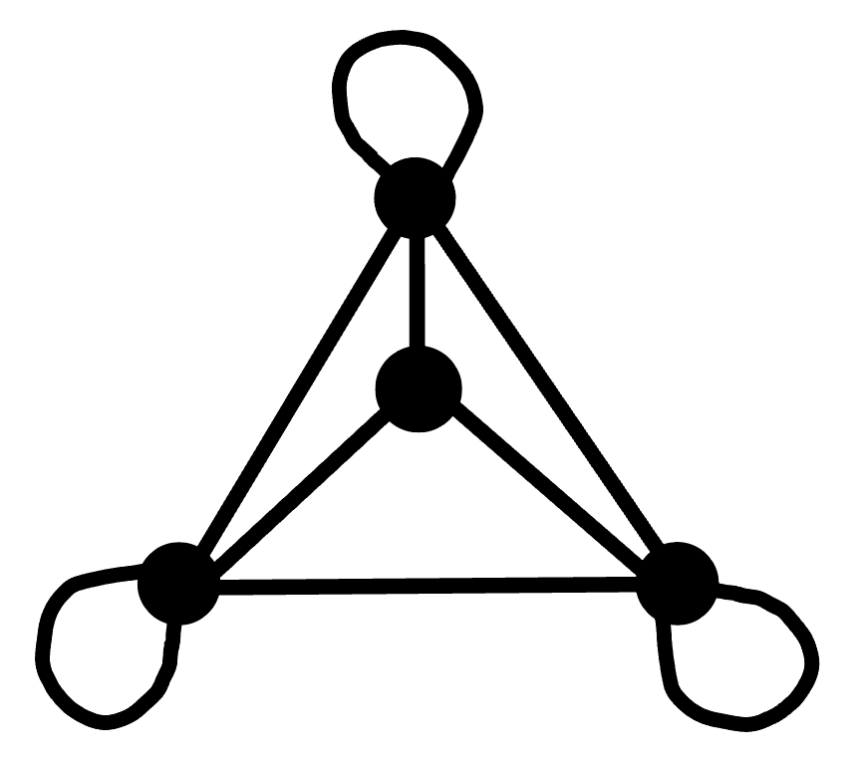
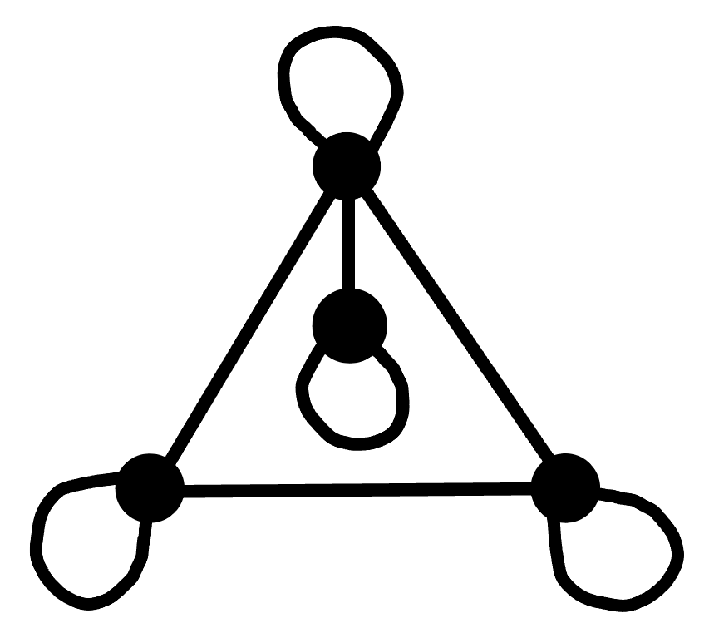
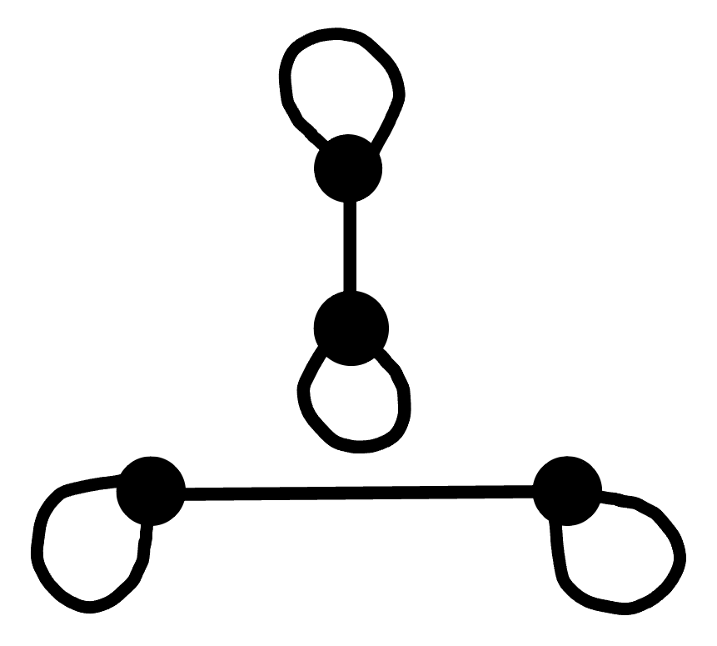
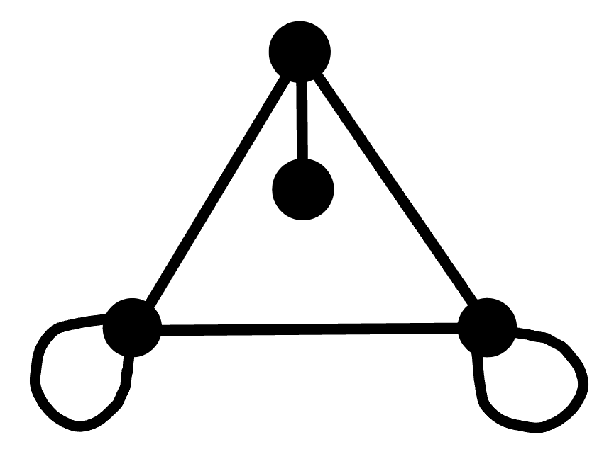
Potential Size-4 Excluded Minors for Binomials
There are 14 size-4 binary delta-matroids whose twist polynomials have 3 or more terms.
Discarding those that are minors of a size-5 binary delta-matroid with a twist binomial leaves the following:

Slide 17
Exponents Appearing in Twist Polynomials
Let D be a delta-matroid.
Let S be the set of numbers appearing as exponents for terms with nonzero coefficients in the twist polynomial of D.
For any 2 numbers in S, choose twists of D with those widths - these 2 twists can be obtained from each other via a sequence of twists by singletons.
Since any singleton twist changes the width by at most 2, the difference between consecutive numbers in S is at most 2.

Slide 18
Twist Binomials
Suppose D is a normal delta-matroid of width m whose twist polynomial has exactly 2 terms.
There are 4 possibilities for the form of the twist polynomial:
1) az^{m} + bz^{m+2}
2) az^{m} + bz^{m+1}
3) az^{m} + bz^{m-1}
4) az^{m} + bz^{m-2}

Slide 19
Excluded Restrictions for az^{m} + bz^{m+2}
Assume D is a normal delta-matroid of width m with a twist binomial of the form az^{m} + bz^{m+2}.
The following results still hold, just as for twist monomials.
{e} ∈ D, {f} ∉ D ⇒ {e, f} ∉ D
{e} ∈ D, {f} ∈ D ⇒ {e, f} ∈ D
However, the next result for twist monomials no longer holds under these assumptions.
{e}, {f}, {g} ∉ D
{e, f}, {e, g} ∈ D
⇒ {f, g} ∈ D

Slide 20
Looped Vertices for az^{m} + bz^{m+2}
Assume D is a normal binary delta-matroid of width m with a twist binomial of the form az^{m} + bz^{m+2}.
Then the graph representing D is a disjoint union of single-vertex loops and an unlooped simple graph.
Thus it suffices to assume that the graph representing D is unlooped, meaning that D is even.

Slide 21
Even Excluded Restrictions
Assume D is an even normal binary delta-matroid of width m with a twist binomial of the form az^{m} + bz^{m+2}.
Which even binary delta-matroids cannot occur as restrictions of D?

Slide 22
Note
A delta-matroid is a minor of a delta-matroid with a twist monomial if and only if it is binary and is represented by a graph that is a disjoint union of single-vertex loops and unlooped complete graphs.
We would like to know which delta-matroids are minors of delta-matroids with twist binomials - this could even be all delta-matroids.

Slide 23
References
I. Moffatt, Delta-matroids for graph theorists, Surveys in combinatorics 2019, 167–220, London Math. Soc. Lecture Note Ser., 446, Cambridge Univ. Press, Cambridge, 2019.
Q. Yan and X. Jin, Twist polynomials of delta-matroids, Adv. in Appl. Math. 139 (2022) 102363.
Q. Yan and X. Jin, Twist monomials of binary delta-matroids, Preprint arXiv:2205.03487v1 [math.CO].

